Slide 1
Statistics for data science II
Solve with Instructor
Week 1

Slide 2
Statistics II: Week 1 Solve with Instructor
How to participate? joinpd.com code: see above
Keep a notebook and pen ready for solving problems
How to join?
Audio/screen share on zoom- click on link sent to you
Doubts? Use zoom chat. Do not answer questions on zoom chat.
Join on pear deck - joinpd.com (enter code seen on top right)
Answer questions only here
For every question - 5 to 15 minutes allotted
Question will be shown in a slide for solving
If you are done solving, enter your answer at joinpd.com
Presenter will provide a solution
Questions and discussion

Slide 3
Prelude 1 to Q1
Three friends Abhi, Vandana, and Chetan are hitting a target. They hit the target independent of each other with probabilities 0.3, 0.6 and 0.7, respectively.
What is the probability that Abhi hits the target but Vandana and chetan does not hit the target?
Notes:
🍐 This is a Pear Deck Number Slide
🍐 To edit the type of question, go back to the "Ask Students a Question" in the Pear Deck sidebar.

Slide 4
Solution:
Define events A, B and C as follows:
A= Abhi hits the target. ⇒ P(A) = 0.3
B= Vandana hits the target. ⇒ P(B) = 0.6
C= Chetan hits the target. ⇒ P(C) = 0.7
To find: P(A ∩ B^{C}∩ C^{C})
Note that: events A, B^{C}, and C^{C} are independent.
It implies that P(A ∩ B^{C}∩ C^{C})= P(A).P(B^{C}).P(C^{C}) = 0.3 (1-0.6)(1-0.7)
= 0.036

Slide 5
Prelude 2 to Q1
Three friends Abhi, Vandana, and Chetan are hitting the target. They hit the target independent of each other with probabilities 0.3, 0.6 and 0.7, respectively.
What is the probability that exactly two of them will hit the target?
Notes:
🍐 This is a Pear Deck Number Slide
🍐 To edit the type of question, go back to the "Ask Students a Question" in the Pear Deck sidebar.

Slide 6
Solution:
Define events A, B and C as follows:
A= Abhi hits the target. ⇒ P(A) = 0.3
B= Vandana hits the target. ⇒ P(B) = 0.6
C= Chetan hits the target. ⇒ P(C) = 0.7
To find: P((A ∩ B ∩ C^{C}) ⋃ (A ∩ B^{C} ∩ C) ⋃ (A^{C} ∩ B ∩ C))
Note that events (A ∩ B ∩ C^{C}), (A ∩ B^{C}∩ C) and (A^{C} ∩ B ∩ C) are pairwise disjoint.
It implies that
P((A ∩ B ∩ C^{C}) ⋃ (A ∩ B^{C} ∩ C) ⋃ (A^{C} ∩ B ∩ C)) = P(A ∩ B ∩ C^{C}) + P(A ∩ B^{C} ∩ C) + P(A^{C} ∩ B ∩ C)
= (0.3)(0.6)(0.3) + (0.3)(0.4)(0.7) + (0.7)(0.6)(0.7) = 0.432

Slide 7
Q1
Three friends Abhi, Vandana, and Chetan are hitting the target. They hit the target independent of each other with probabilities 0.3, 0.6 and 0.7, respectively.
What is the conditional probability that Abhi does not hit the target given that exactly two of them hits the target?
Notes:
🍐 This is a Pear Deck Number Slide
🍐 To edit the type of question, go back to the "Ask Students a Question" in the Pear Deck sidebar.

Slide 8
Solution:
Define events A, B and C as follows:
A= Abhi hits the target. ⇒ P(A) = 0.3
B= Vandana hits the target. ⇒ P(B) = 0.6
C= Chetan hits the target. ⇒ P(C) = 0.7
Let X denotes the event that exactly two of them hit the target.
From previous question,
X = (A ∩ B ∩ C^{C}) ⋃ (A ∩ B^{C} ∩ C) ⋃ (A^{C} ∩ B ∩ C) and
P(X) = 0.432

Slide 9
Continue..
To find: P(A^{C} | X)
P(A^{C} | X) = P(A^{C}∩ X) / P(X)
= P(A^{C}∩ ((A ∩ B ∩ C^{C}) ⋃ (A ∩ B^{C} ∩ C) ⋃ (A^{C} ∩ B ∩ C))) / P(X)
= P(A^{C} ∩ B ∩ C) / P(X)
= (0.7)(0.6)(0.7) / 0.432
= 0.68

Slide 10
Q2
In a town, 70% of the residents are eligible for voting in an election but only 60% of the eligible residents voted in the election. A person is randomly selected from the town.
What is the conditional probability that the person is eligible for the voting given that he or she did not vote?
Notes:
🍐 This is a Pear Deck Number Slide
🍐 To edit the type of question, go back to the "Ask Students a Question" in the Pear Deck sidebar.

Slide 11
Solution:
Define events A and B as follows:
A = Randomly selected person is eligible for voting.
B = Randomly selected person has voted.
Given that:
P(A) = 0.7
P(B|A) = 0.6 It implies that P(B^{C}|A) = 0.4
Note that P(B^{C}|A^{C}) = 1
To find: P(A| B^{C})

Slide 12
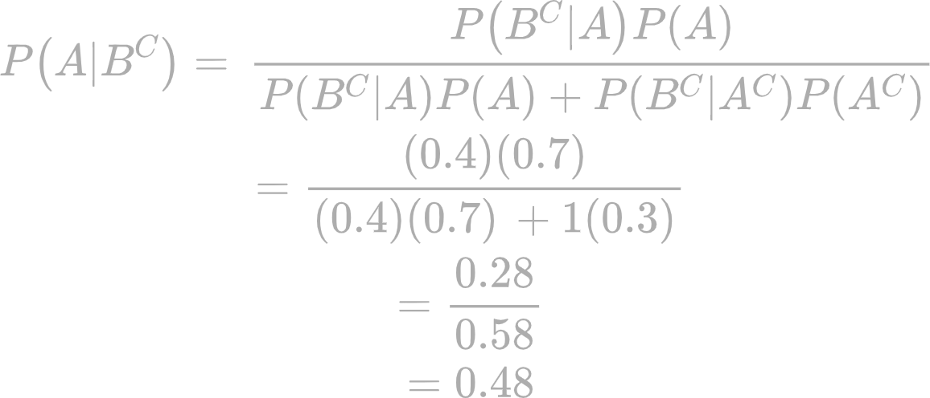
Continue..
Now,

Slide 13
Prelude 1 to Q3
There are seven black and three white marbles in a box. Two marbles are removed randomly from the box.
What is the probability that removed marbles have one white marble?
Notes:
🍐 This is a Pear Deck Number Slide
🍐 To edit the type of question, go back to the "Ask Students a Question" in the Pear Deck sidebar.

Slide 14
Solution:
There are total 10 marbles in the box (seven black and three white). Two marbles are removed randomly.
Since these marbles are removed randomly, colors of the removed marbles can either be white or black or both.
Number of ways of removing two marbles at random = ¹⁰C₂
Number of ways of removing one white marble = ³C₁
Number of ways of removing one black marble = ⁷C₁

Slide 15
Continue..
So probability of removing two marbles such that exactly one removed marble is of white color is given as
P(removed marbles have one white marble) = ³C₁.⁷C₁/¹⁰C₂
= 3*7/45
= 0.47

Slide 16
Prelude 2 to Q3
There are seven black and three white marbles in a box. Two marbles are removed randomly from the box. Now, a person selects one marble from the remaining eight marbles.
If removed marbles contain one black and one white marble, what is the probability that person selects the black marble?
Notes:
🍐 This is a Pear Deck Number Slide
🍐 To edit the type of question, go back to the "Ask Students a Question" in the Pear Deck sidebar.

Slide 17
Solution:
If removed marbles contain one black and one white marble, then there will be six black and two white marbles in the box.
Therefore,
P(person selects black marble) = 6 / 8 = 0.75

Slide 18
Q3
There are seven black and three white marbles in a box. Two marbles are removed randomly from the box. Now, a person selects one marble from the remaining eight marbles.
What is the probability that person selects the black marble?
Notes:
🍐 This is a Pear Deck Number Slide
🍐 To edit the type of question, go back to the "Ask Students a Question" in the Pear Deck sidebar.

Slide 19
Solution
Define events A, B, and C as follows:
A = removed marbles contain no black marble.
B = removed marbles contain one black marble.
C = removed marbles contains two black marbles.
P(A) = ³C₂.⁷C₀/¹⁰C₂ = 3/45
P(B) = ³C₁.⁷C₁/¹⁰C₂= 21/45
P(C) = ³C₀.⁷C₂/¹⁰C₂ = 21/45

Slide 20
Continue…
Let X be the event that person selects the black marble.
Then,
P(X|A) = 7 / 8
P(X|B) = 6 / 8
P(X|C) = 5 / 8
By law of total probability, we have
P(X) = P(X|A)P(A) + P(X|B)P(B) + P(X|C)P(C)
= ⅞ (3/45) + 6/8 (21/45) + ⅝ (21/45) = 0.7

Slide 21
Prelude 1 to Q4
Urn A contains 5 red and 3 blue marbles while urn B contains 6 red and 4 blue marbles. A fair die is rolled. If the die shows up an even number, a marble is chosen from urn A, if it
shows up an odd number, a marble is chosen from urn B.
If Rahul rolls the die and chooses the marble from an urn according to what he gets on the die, what is the probability that he chooses the red marble?
Notes:
🍐 This is a Pear Deck Multiple Choice Slide. Your current options are: A: 49/80, B: 1/2, C: 33/80, D: Noe of the above,
🍐 To edit the type of question or choices, go back to the "Ask Students a Question" in the Pear Deck sidebar.

Slide 22
Solution:
Define the events as follows:
X = Die shows up an even number.
Y = Die shows up an odd number.
R = Rahul gets a red marble.
B = Rahul gets a blue marble.
P(X) = 3/6 = ½
P(Y) = 3/6 = ½
P(R|X) = ⅝ P(B|X) = ⅜ (Since he chooses from urn A if he gets an even number)
P(R|Y) = 6/10 = 3/5 P(B|Y) = 4/10 = 2/5 (Since he chooses from urn B if he gets an odd number)

Slide 23
Continue...
By law of total probability, we have,
P(R) = P(R|X)P(X) + P(R|Y)P(Y)
= ⅝(1/2) + ⅗(1/2)
= 49/80 = 0.6125

Slide 24
Q4
Urn A contains 5 red and 3 blue marbles while urn B contains 6 red and 4 blue marbles. A fair die is rolled. If the die shows up an even number, a marble is chosen from urn A, if it
Shows up an odd number, a marble is chosen from urn B.
Suppose Rahul who rolls the die gets a red color marble. What is the probability that the marble is drawn from the urn A?
Notes:
🍐 This is a Pear Deck Number Slide
🍐 To edit the type of question, go back to the "Ask Students a Question" in the Pear Deck sidebar.

Slide 25
Solution:
Define the events as follows:
X = Die shows up an even number.
Y = Die shows up an odd number.
R = Rahul gets an red marble.
B = Rahul gets an blue marble.
P(X) = 3/6 = ½
P(Y) = 3/6 = ½
P(R|X) = ⅝ P(B|X) = ⅜ (Since he chooses from urn A if he gets an even number)
P(R|Y) = 6/10 = 3/5 P(B|Y) = 4/10 = 2/5 (Since he chooses from urn B if he gets an odd number)

Slide 26
Continue...
To find: P(X|R)
By bayes’ theorem
P(X|R) = P(R|X)P(X) / P(R)
= (⅝)(½ ) / (49/80)
= 25/49
=0.51

Slide 27
THANK YOU

